Slide 1


Breaking the ransomware toolset
First Name Surname, Role Truesec

Slide 2
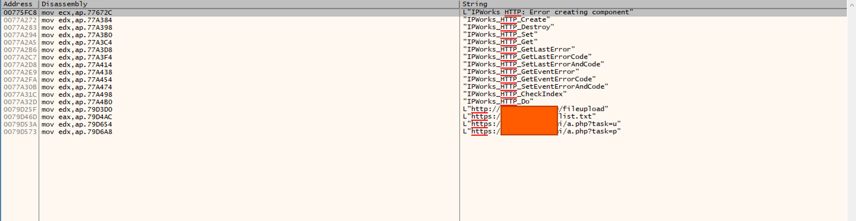
Stuck in the unpacking

Slide 3
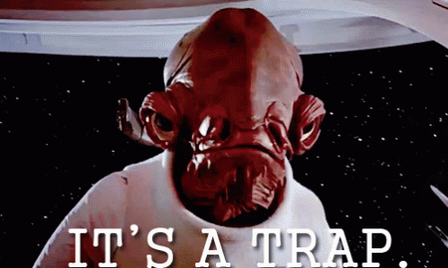
Hmmmmmmmm

Slide 4
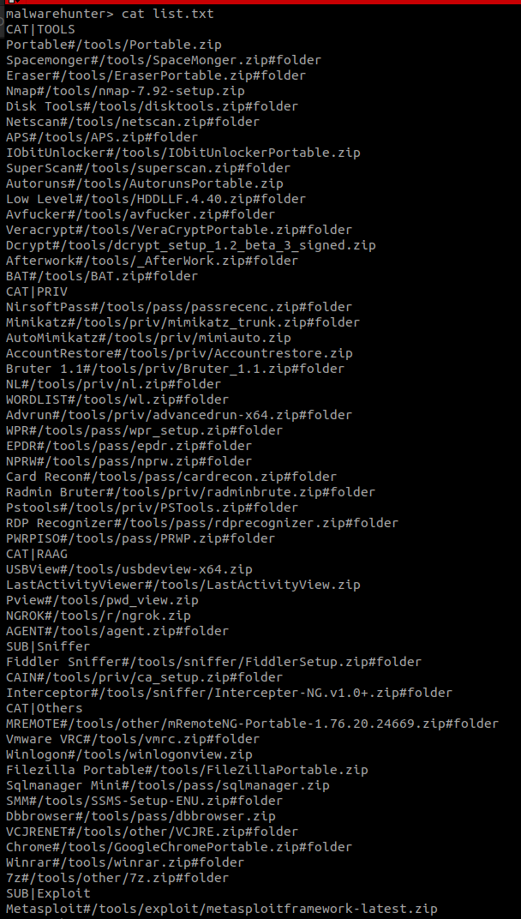
wget https://x.x.x.x/list.txt --no-check-certificate

Slide 5
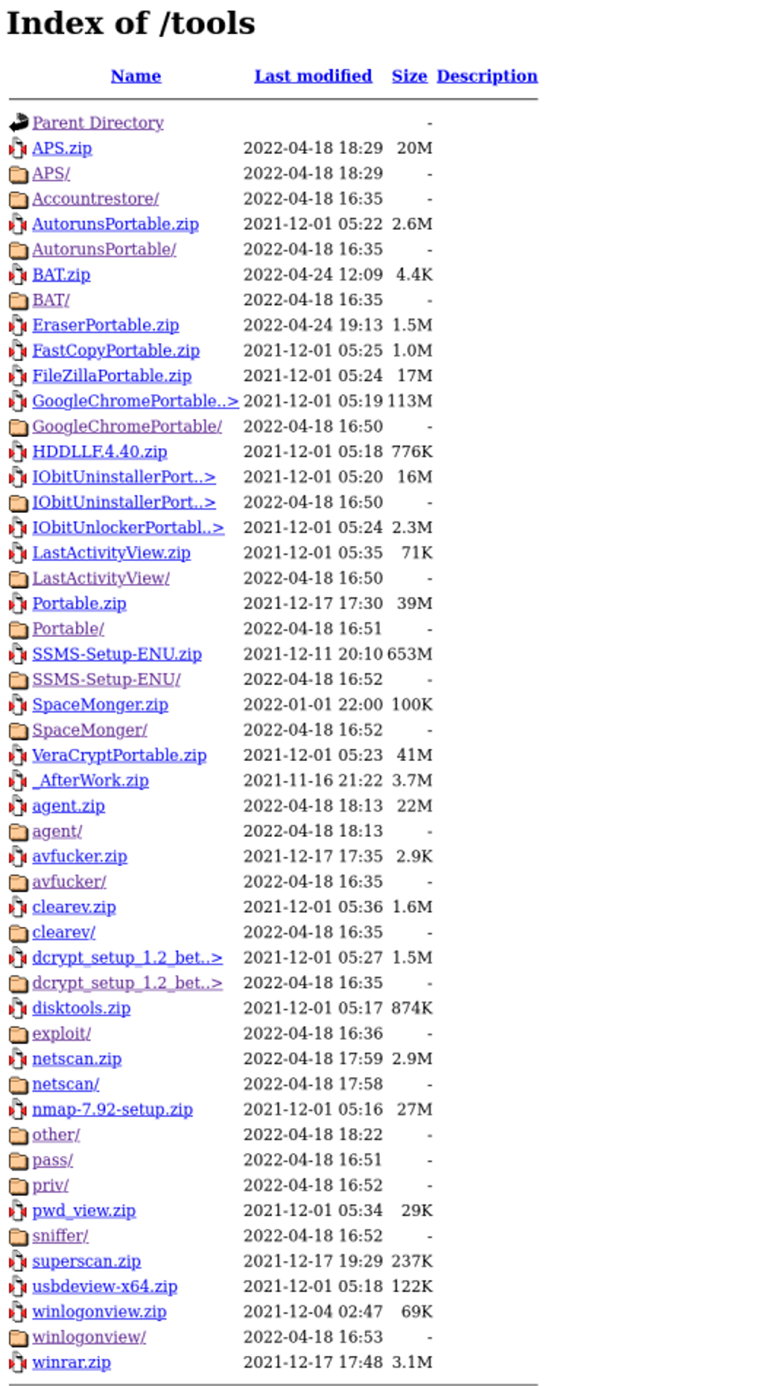
Tools of the trade

Slide 6
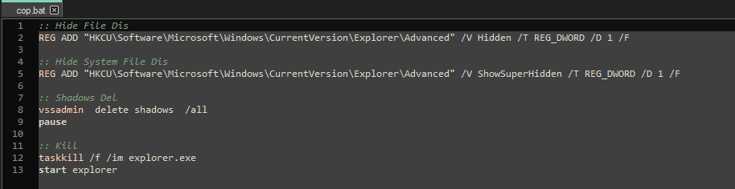
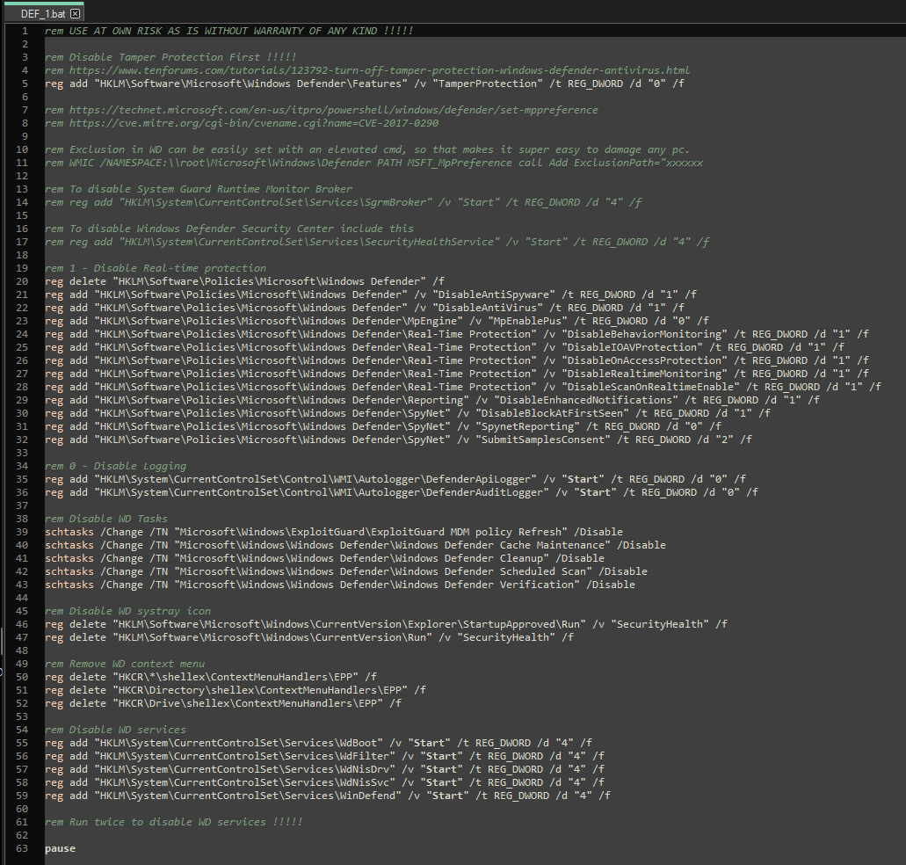
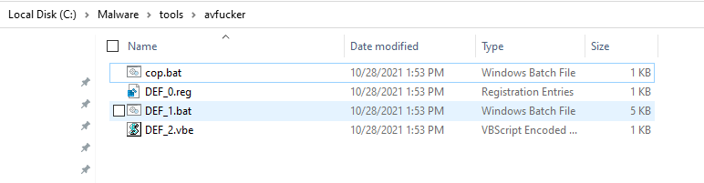
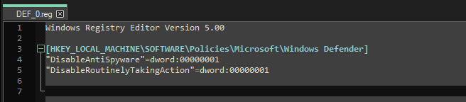
Threat actors hates VSS

Slide 7
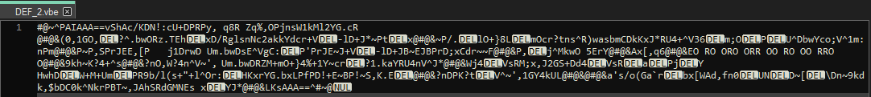
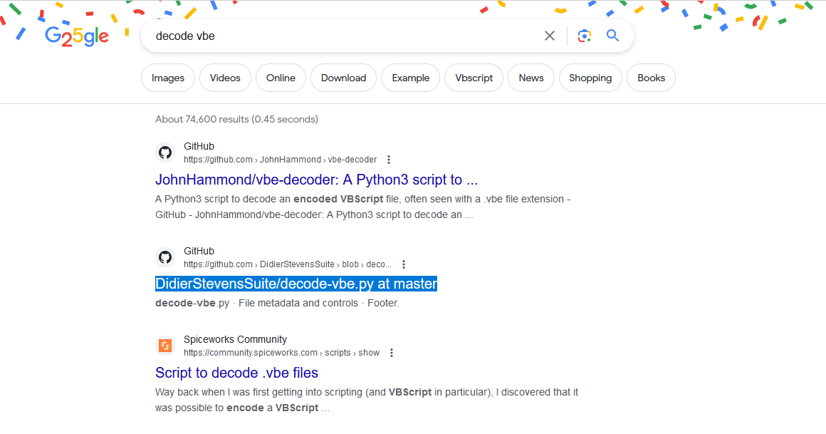
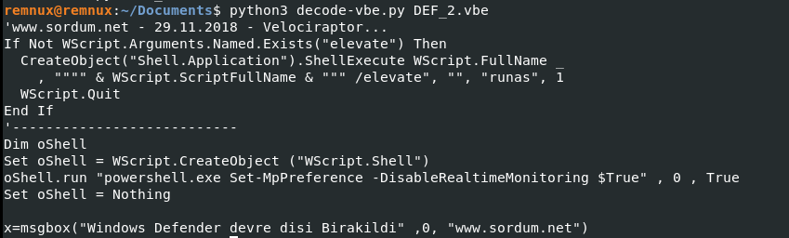
Threat actors hates VSS part 2

Slide 8
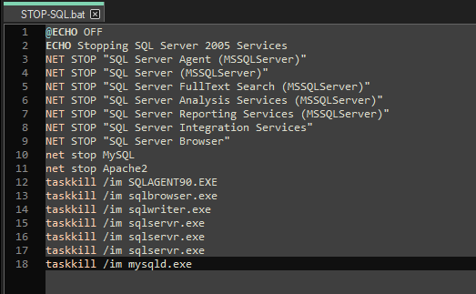
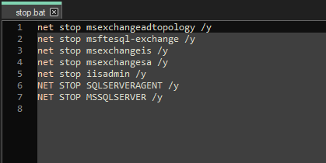
Stopping things

Slide 9
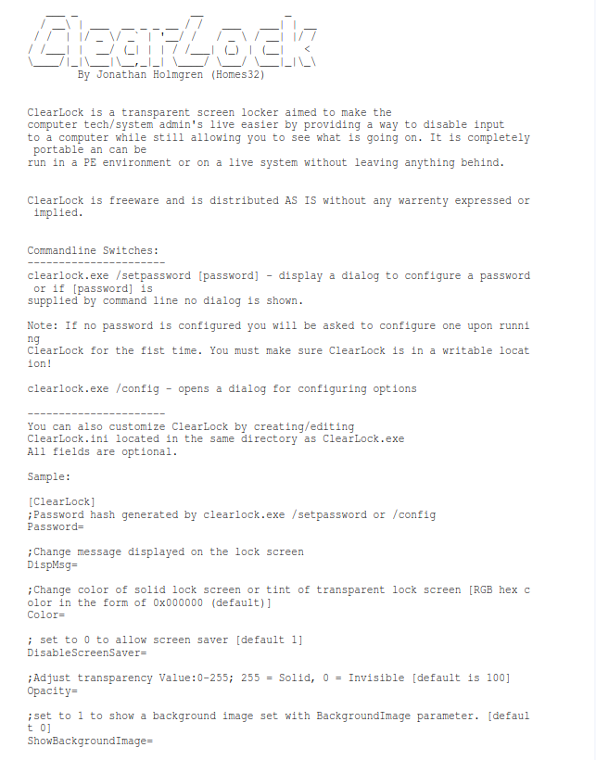
ClearLock

Slide 10
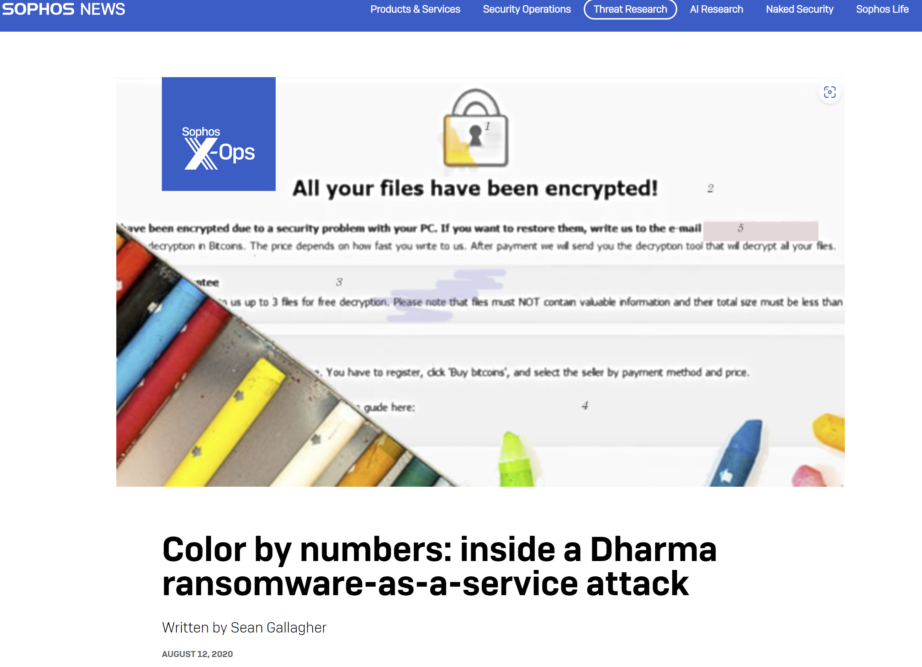
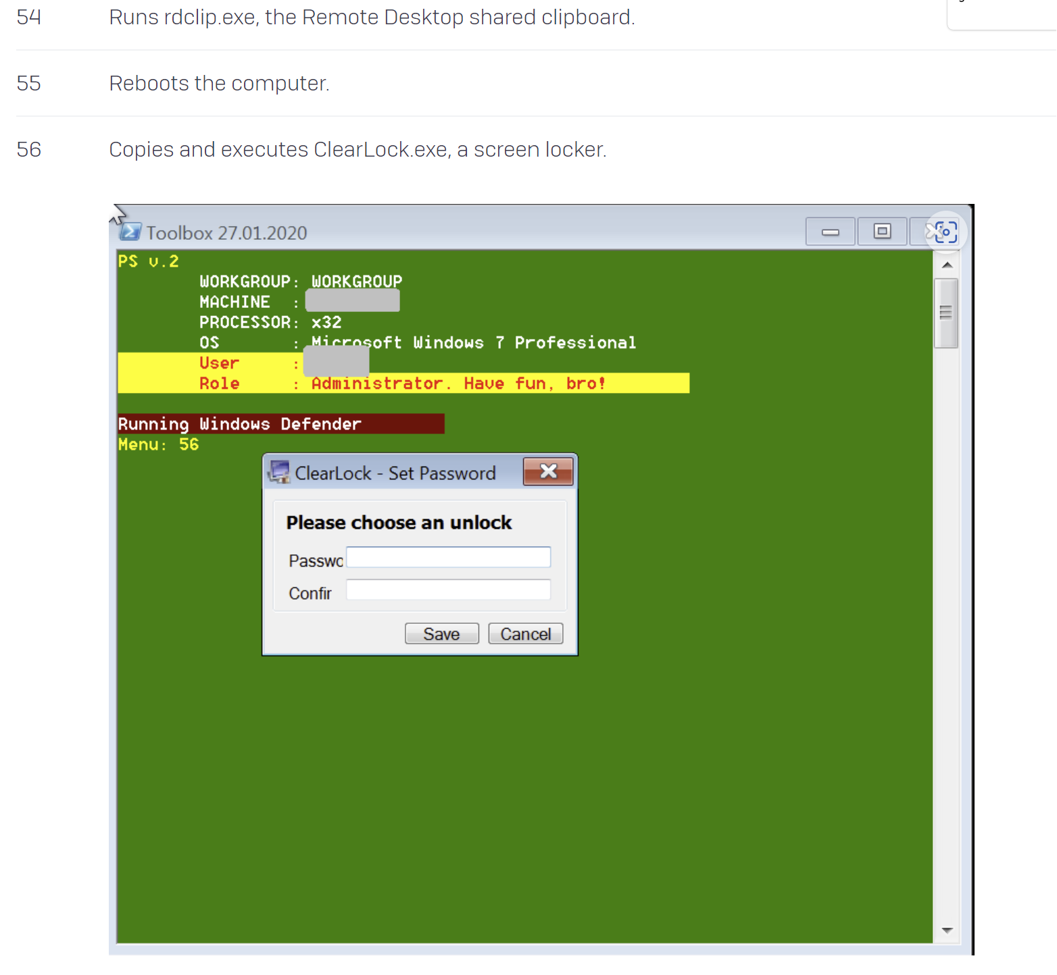
ClearLock

Slide 11
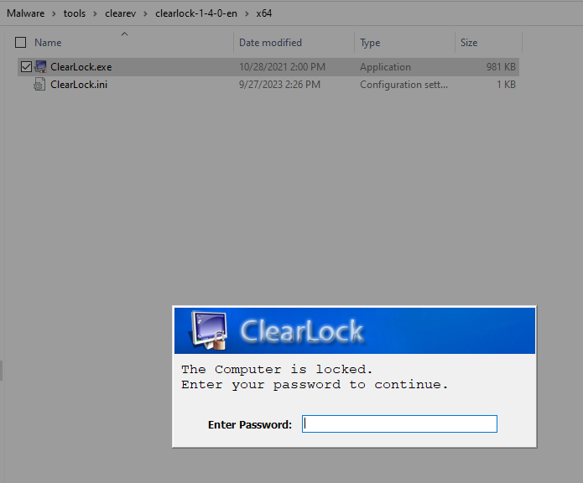
ClearLock

Slide 12
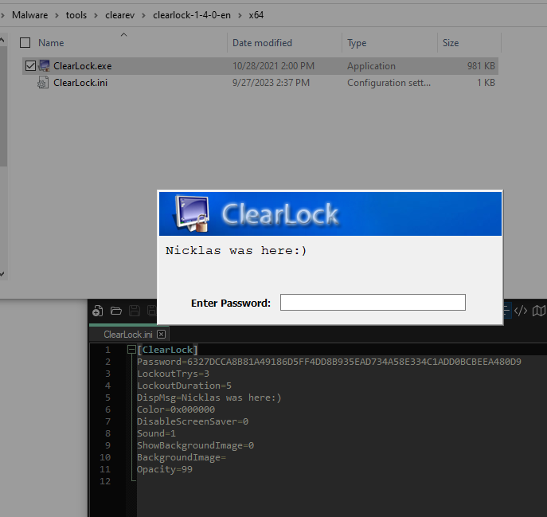
ClearLock

Slide 13
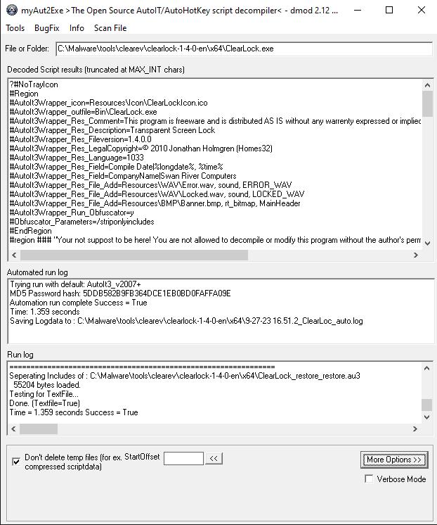
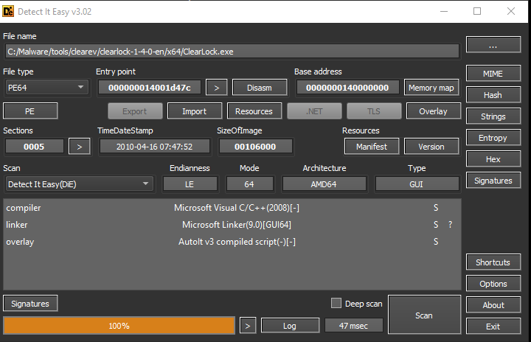
ClearLock

Slide 14
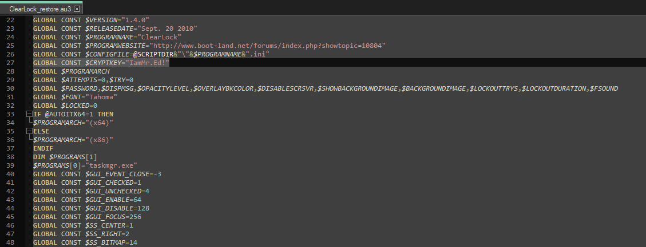
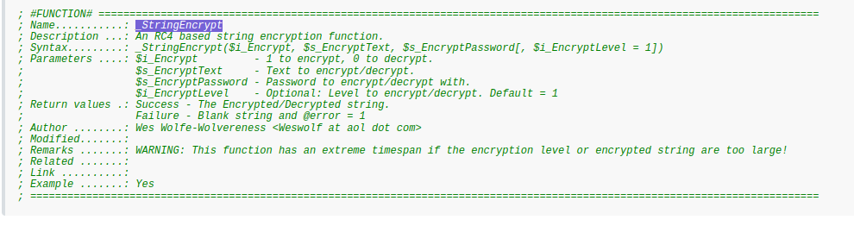
ClearLock

Slide 15
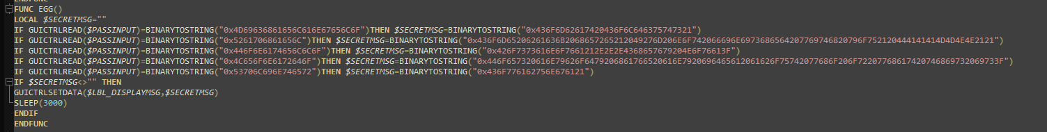
ClearLock

Slide 16
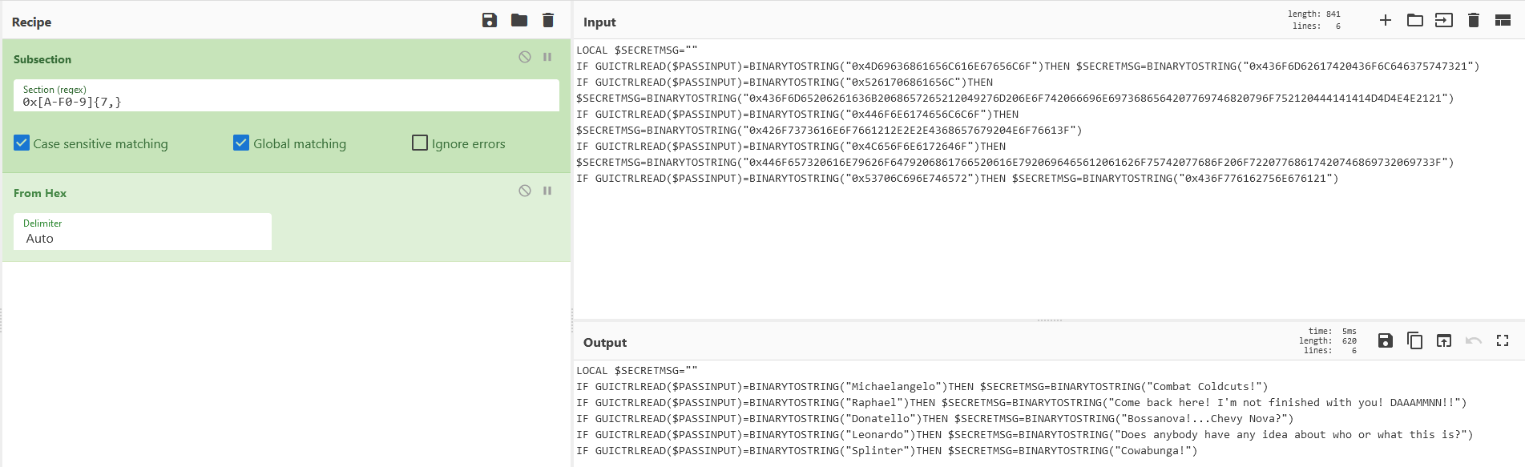
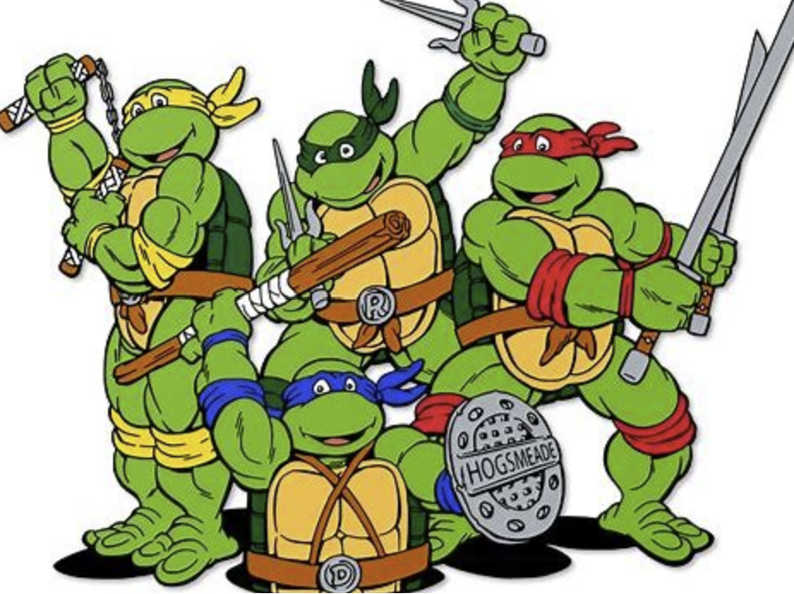
ClearLock

Slide 17
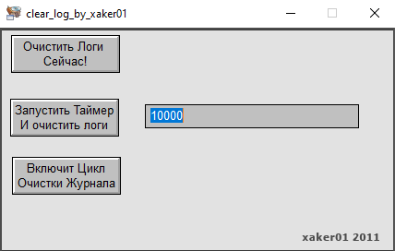
lsass.exe

Slide 18
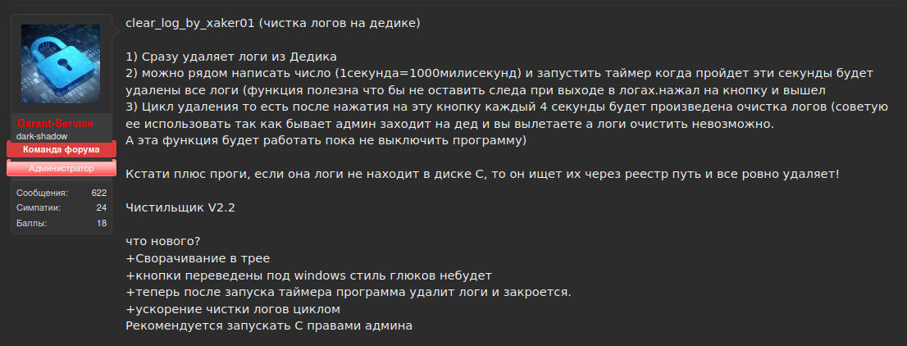
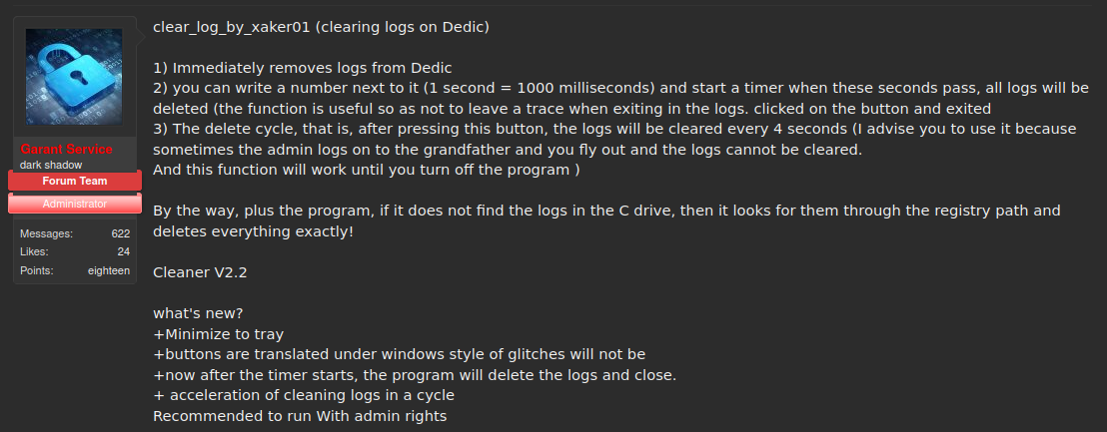
lsass.exe

Slide 19
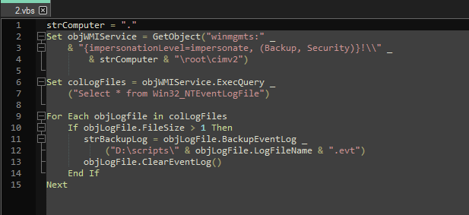
lsass.exe

Slide 20
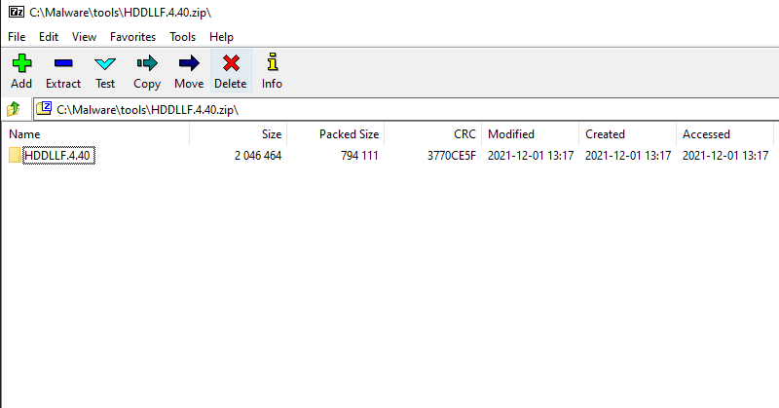
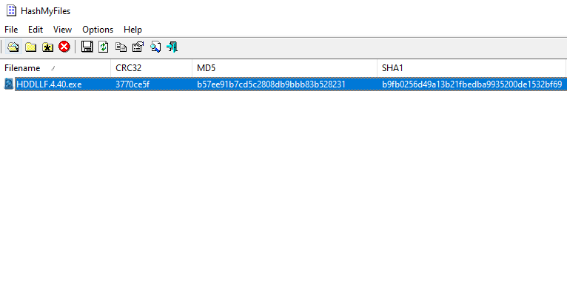
Password protected zip files

Slide 21
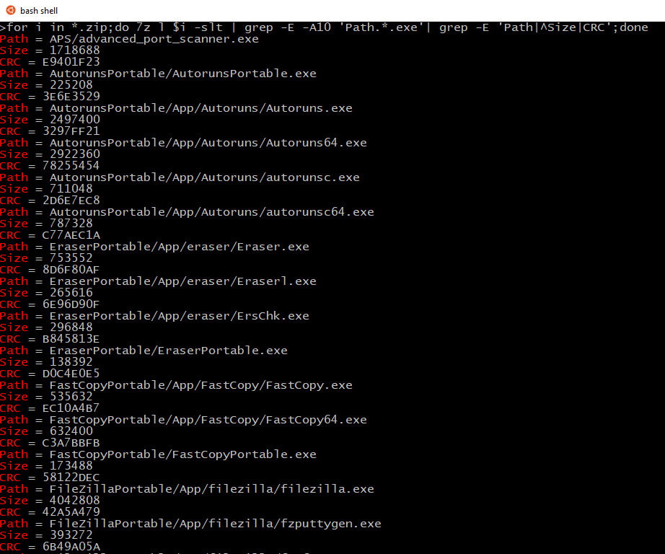
Oneliners
for i in *.zip;do 7z l $i -slt | grep -E -A10 'Path.*.exe' | grep -E 'Path|^Size|CRC';done

Slide 22
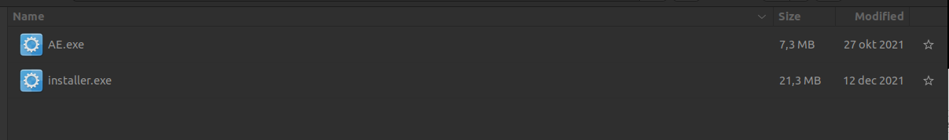
Agents

Slide 23
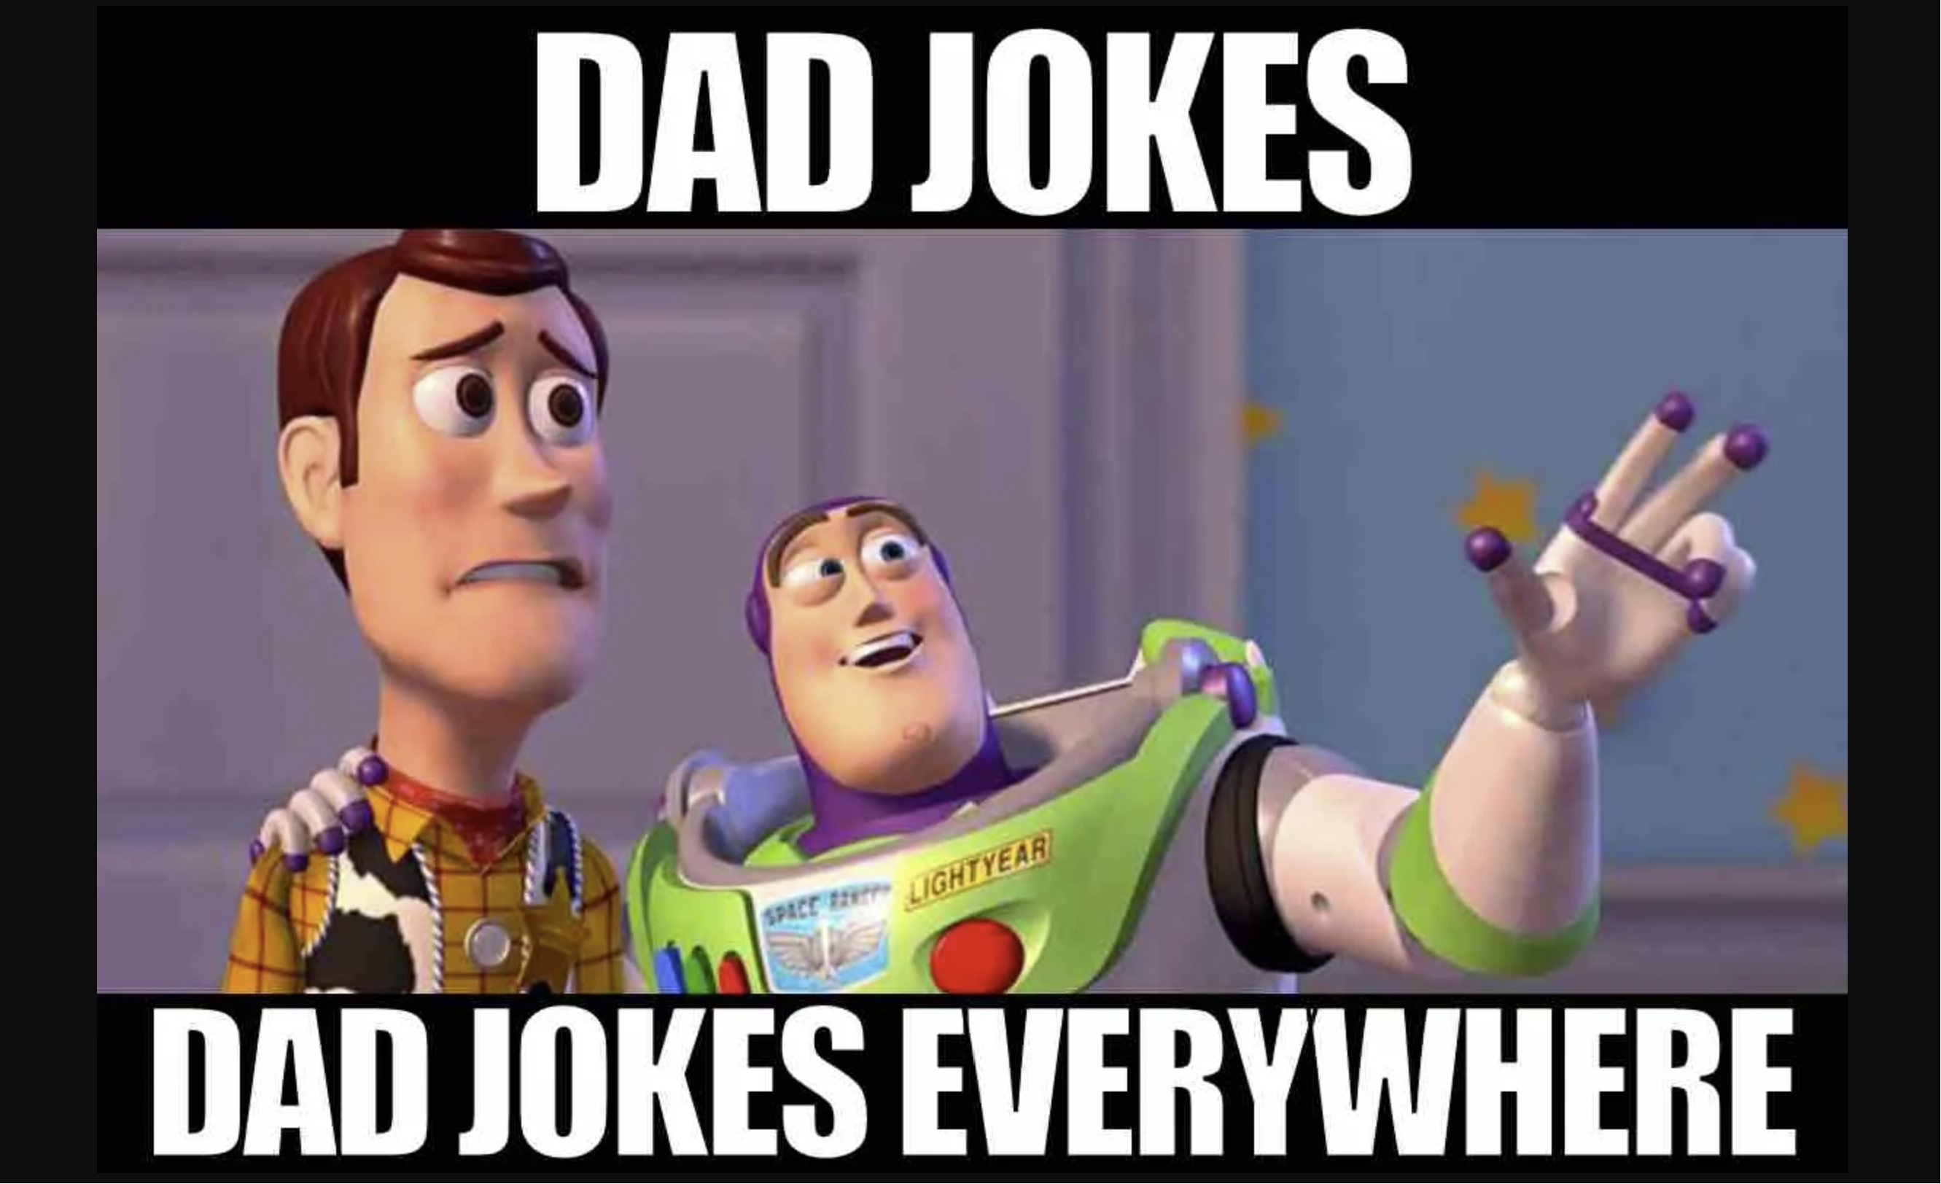

Agents?

Slide 24
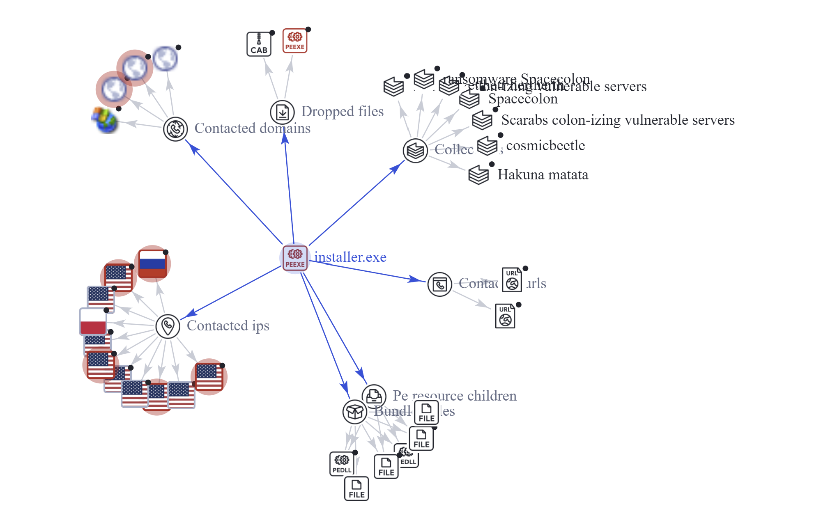
Agents – agent 1

Slide 25
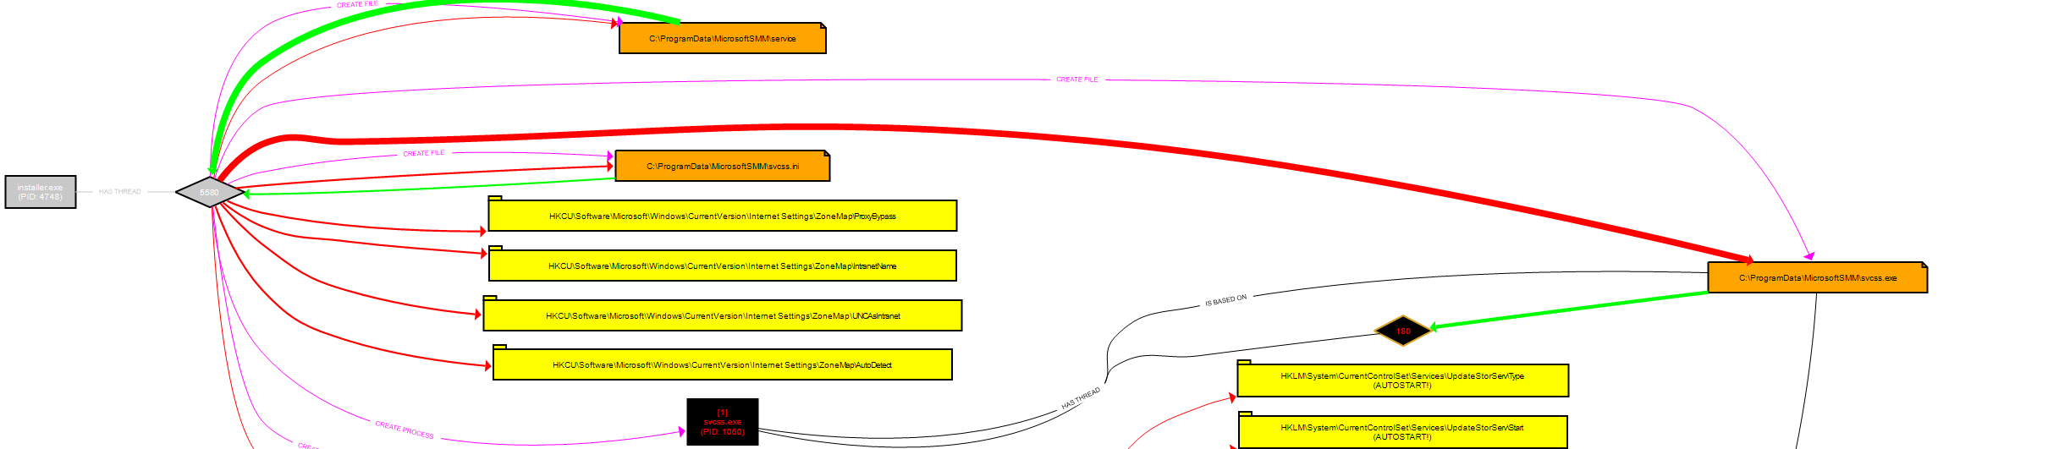
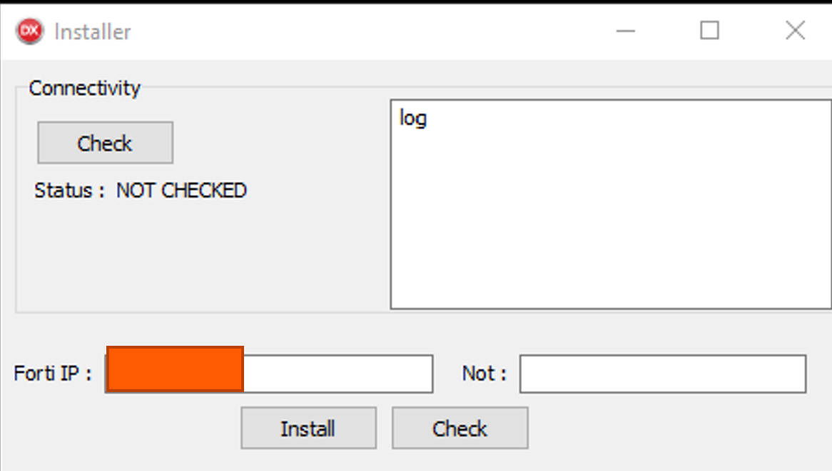
Agents – agent 1

Slide 26
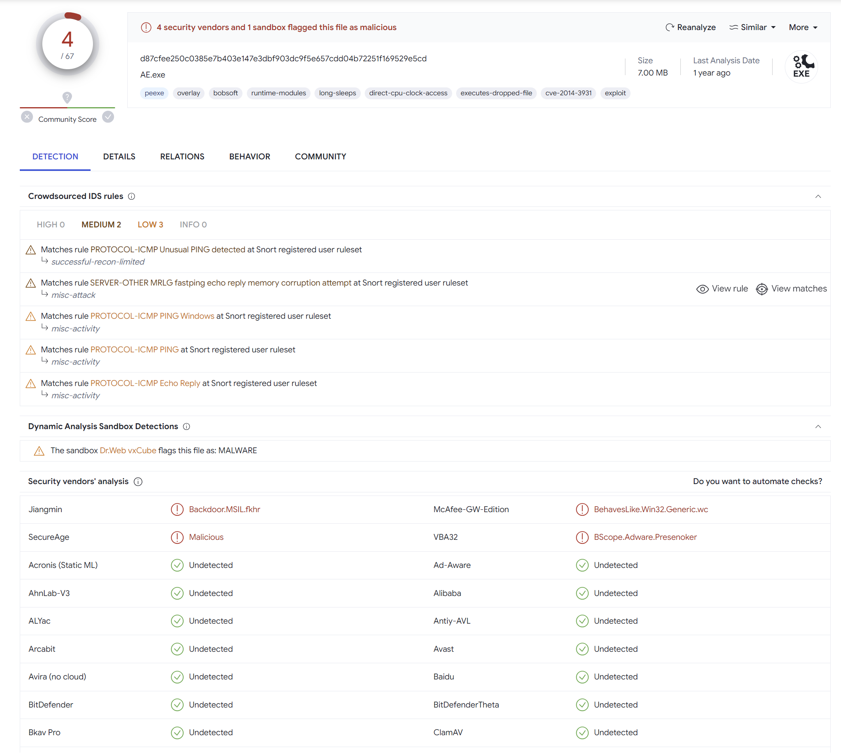
Agents – agent 2

Slide 27
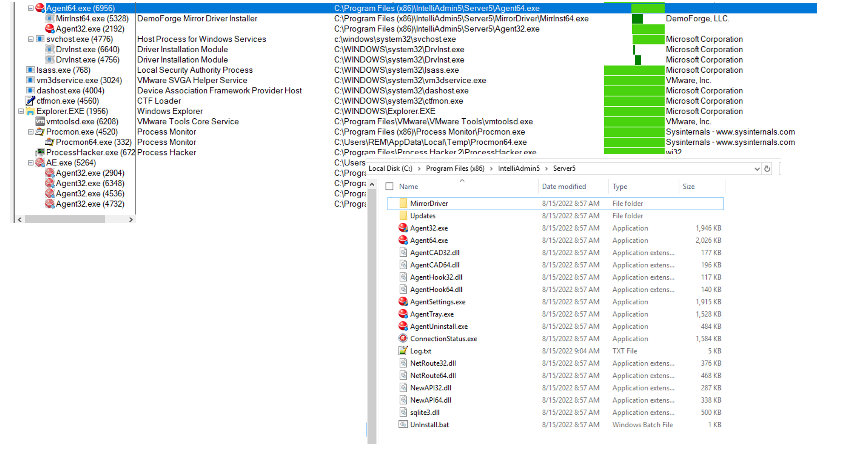
Agents – agent 2

Slide 28
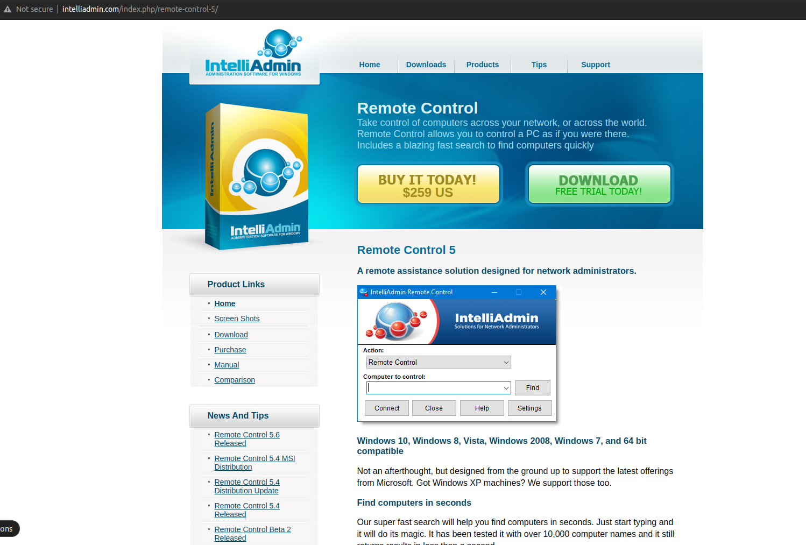
Agents – agent 2

Slide 29
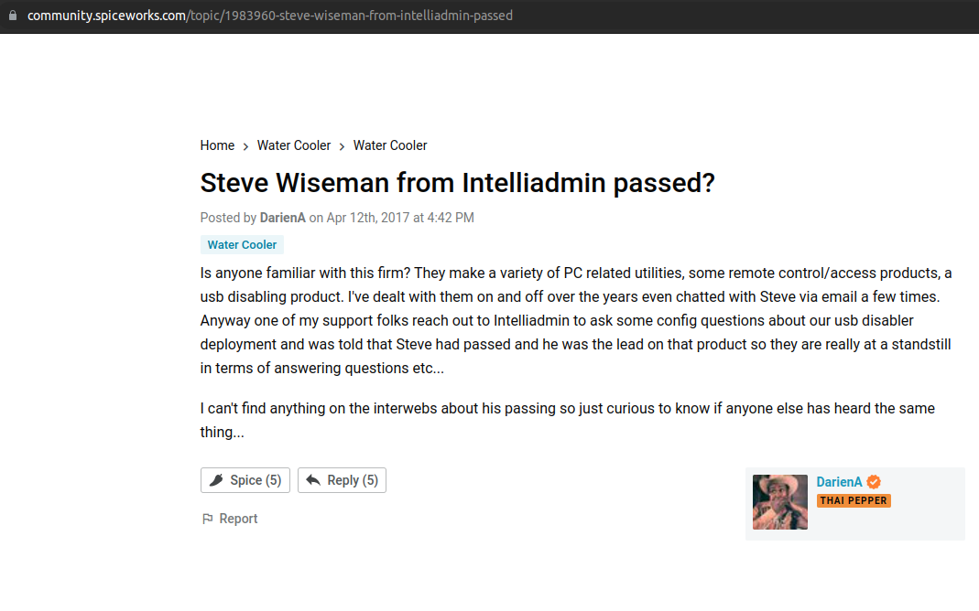
Agents – agent 2

Slide 30
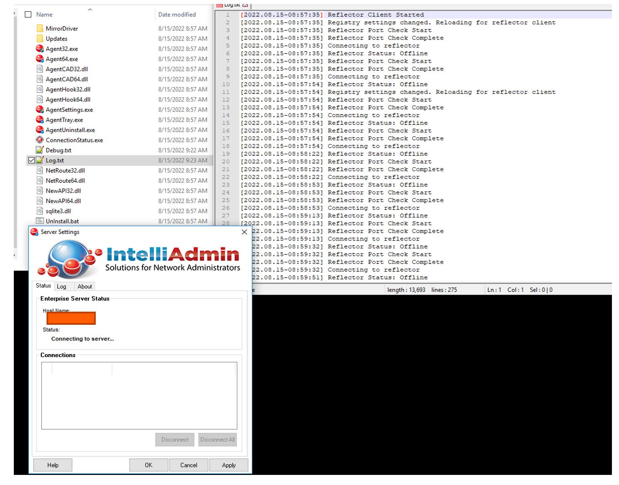
Agents – agent 2

Slide 31
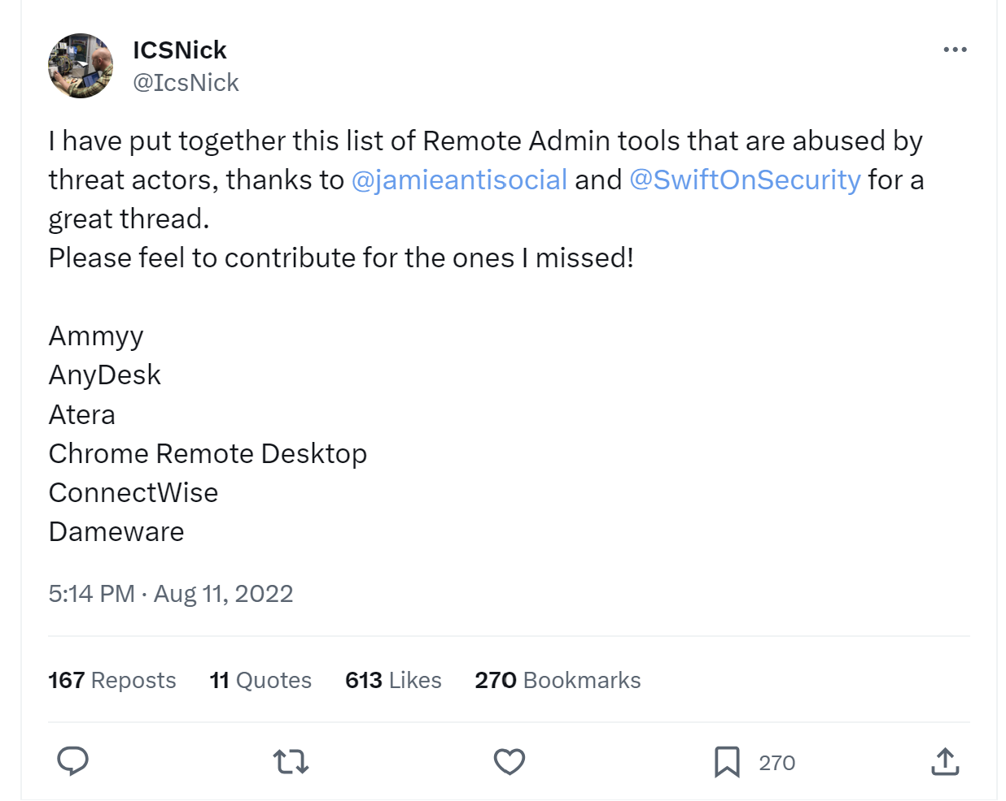
Remote admin tools

Slide 32
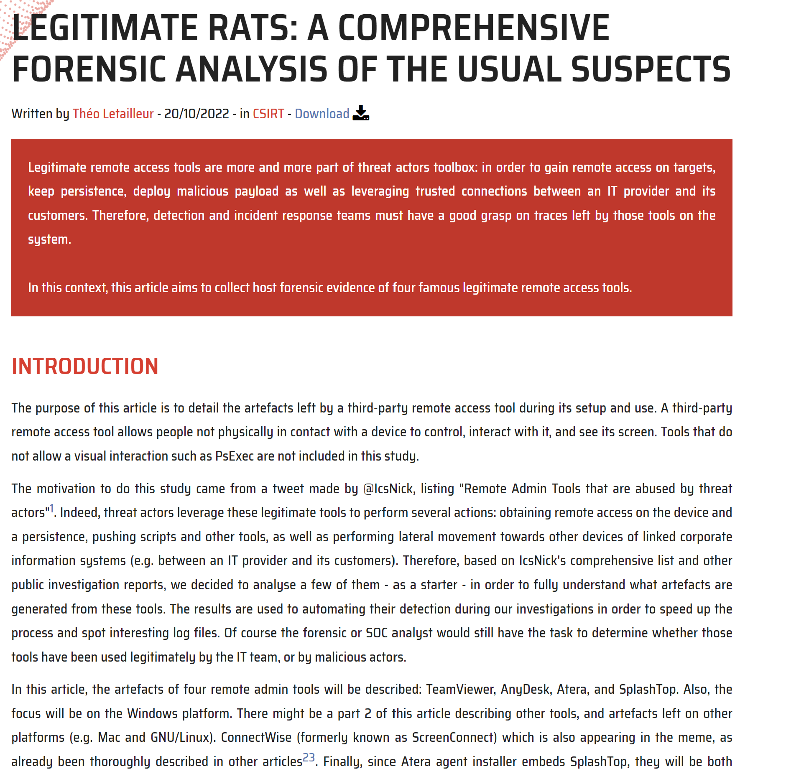
Remote admin tools

Slide 33
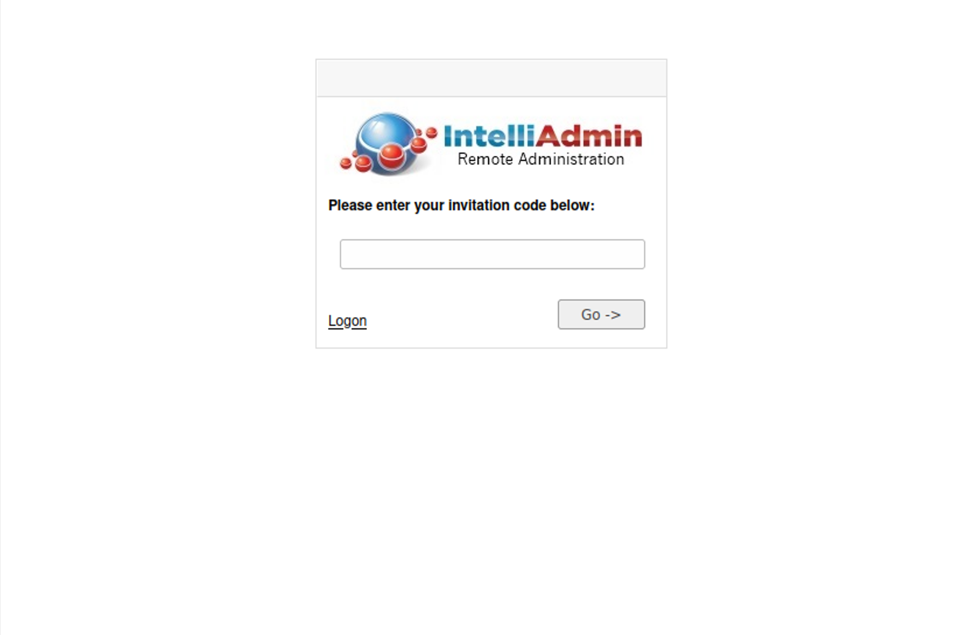
Threat intel - IntelliAdmin

Slide 34
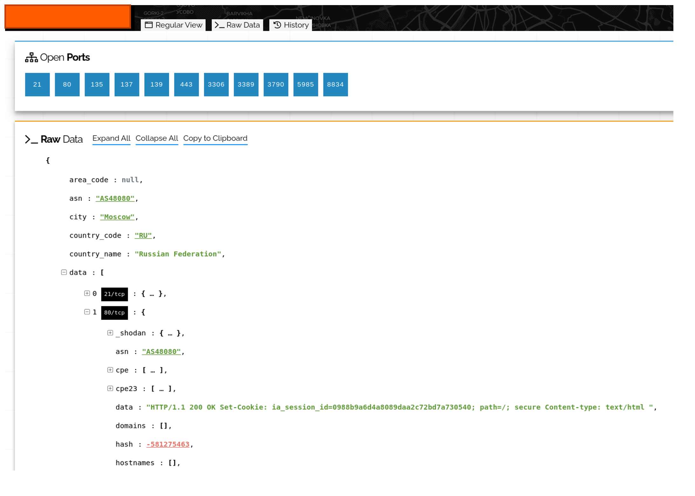
Threat intel - IntelliAdmin

Slide 35
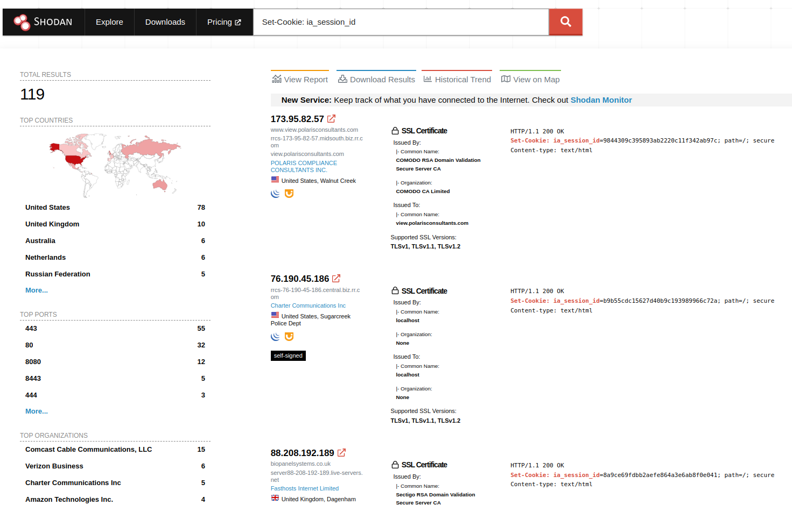
Threat intel - IntelliAdmin
Search: Set-Cookie: ia_session_id

Slide 36
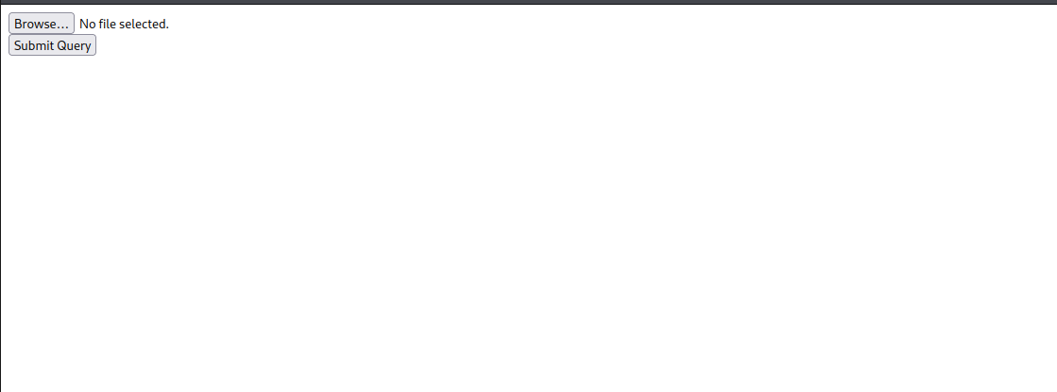
Threat intel - RAT

Slide 37
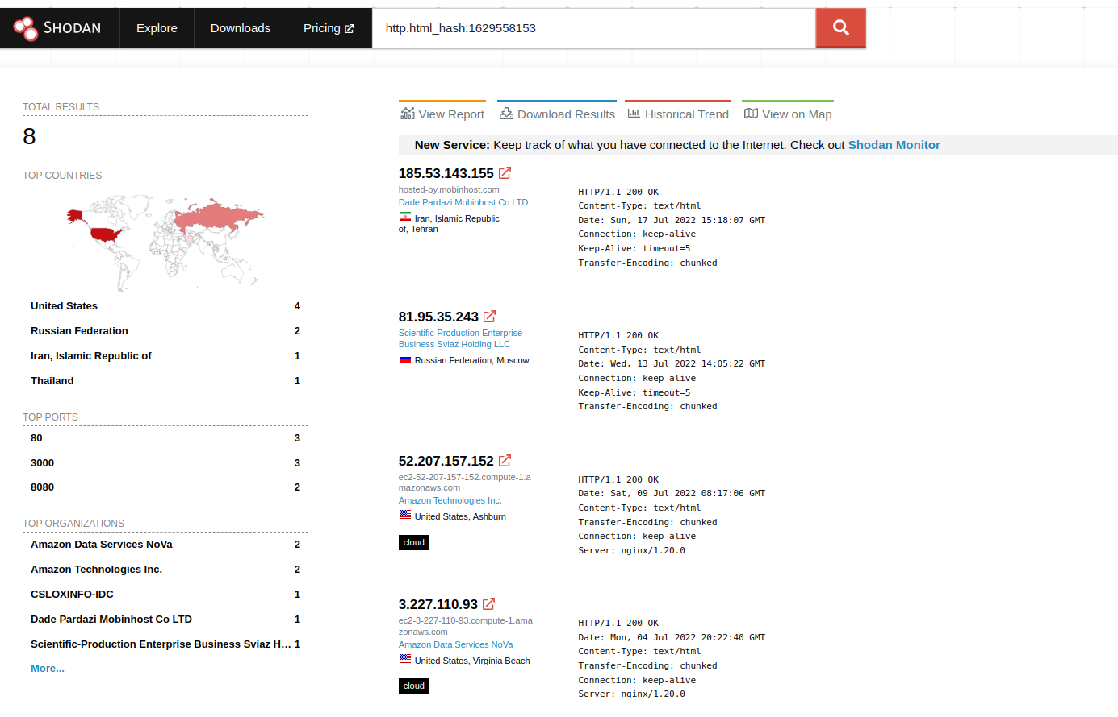
Threat intel - RAT
Search: Set-Cookie: http.html_hash:1629558153

Slide 38

Summery
Director of Operations – CSIRT
Leverage the threat actors weaknesses to build threat intel
Threat actors usually reuse tooling, detection engineering is very important
Blue team always win :)

Slide 39
Thank You!
Notes:
We are experts in many areas. All of them are directly connected to our vision and mission.
This picture is used to show our full range of services.
Many of our customer does not know everything we are experts on and do daily for other customers.
Use orange border to highlight certain areas.
Could be areas the customer are familiar with or are already using from us, or something else.
(You do not need to high light areas if you don’t want to.)

